Slide 1



Reliance GET Summer Internship Program-2025

Slide 2


RELIANCE INDUSTRIES LIMITED
JAMNAGAR MANUFACTURING DIVISION
Project Title
Wireless Fire and Gas Detectors Study and Commissioning
Prepared by
Satyaprakash Rath (19604281)
Project Guide & Mentor
Mr.Bhavik Shah
CES Instrumentation
Co-Guides : Mr.Rajnikumar Ghadiya

Slide 3

Project Charter
Objective
➤ Understanding of complete Wireless FGDS architecture. ➤ Commissioning of WirelessHART-based detectors and repeaters. ➤ Integration with SCADA/DCS via 1410S Gateway. ➤ RF network planning and multi-hop mesh design. ➤ Calibration and functional testing of field devices. ➤ Data flow verification from field to control room. ➤ Knowledge of WirelessHART protocol (IEC 62591, TDMA, FHSS). ➤ Documentation of configuration, diagnostics, and maintenance. | ➤ Plot plan/layout ➤ RF site survey data ➤ Hazardous area classification ➤ SCADA/DCS interface requirements ➤ Alarm logic and gas threshold levels
➤ Vanguard CH4/H2S Gas Detectors ➤ 648DX Repeaters ➤ 781S Field Link Antenna ➤ 1410S Gateway ➤ Emerson ROC800 RTU (**Optional- Not Used in Project) ➤ Cable(2Px1.00mm2 Signal Armoured)between Gateway & Antenna to ensure zero data loss and EMI & RFI Protection ➤ Lithium Battery Packs ➤ WirelessHART Power Module | ➤ Purpose of the Project. ➤ Why Shift from Wired to Wireless System? ➤ Overview of DTA F&G System. ➤ Existing Architecture of WirelessHART Enabled F&G System. ➤ Proposed Wireless System Architecture & Components. ➤ Detailed Working of System Components. ➤ Commissioning Process – Phases. ➤ Key Differences Between Wired & Wireless F&G System. ➤ Pros & Cons of Wireless F&G System. ➤ Conclusion. ➤ Learnings. ➤ Annexure.
To design Wireless F&G System and understand system components and working principle
Outcomes/Deliverables
Inputs
Devices Required
Presentation Flow

Slide 4



Purpose
So why to upgrade from wired to wireless system?
Why to use Wireless HART
Is it really better?
Wireless F&G systems use a mesh architecture with detectors, repeaters, and gateways communicating via WirelessHART, ensuring redundant, self-healing paths.
Devices are battery-powered with a typical life of 5–10 years(dependent on Scan Time), reducing maintenance frequency.
WirelessHART uses TDMA and FHSS for reliable, interference-resistant communication in industrial environments.
Gateways collect multi-variable data and transmit to SCADA/DCS over Ethernet or Modbus TCP/IP.
The system eliminates extensive cabling, reducing installation time and cost.
Scalability and relocation of devices are easy without physical wiring changes.
Wireless HART transmits multiple variables and diagnostics, unlike 4–20 mA which carries only one signal.
It forms a self-healing mesh network, ensuring reliable communication even if one path fails.
Devices can be monitored, configured, and diagnosed remotely without physical access.
It eliminates extensive wiring, cutting installation time and cost in hazardous or remote areas.
Battery-powered devices allow deployment where power and cabling are impractical.
The system is easily scalable and reconfigurable without disrupting existing infrastructure.

Slide 5

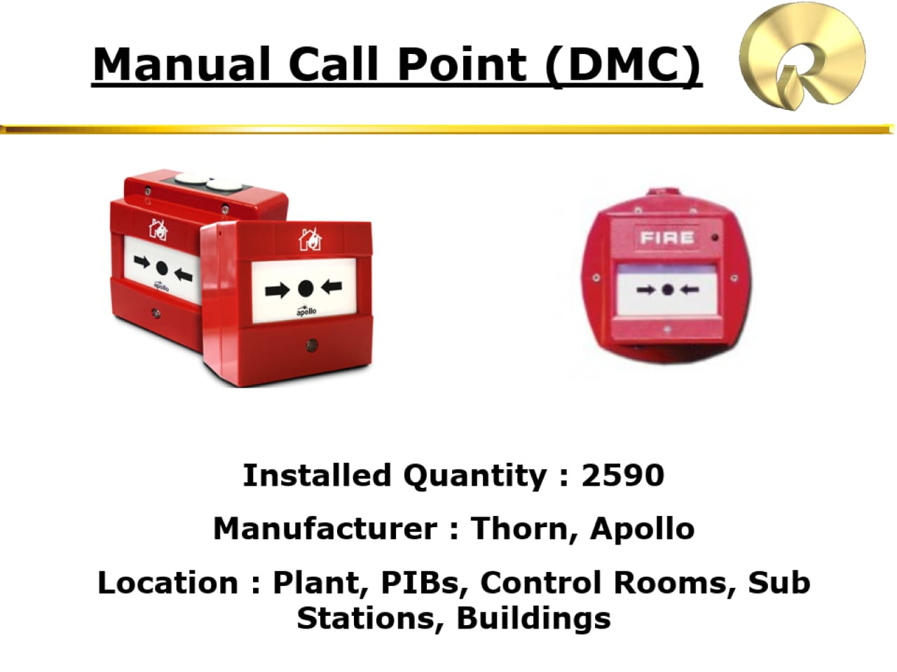

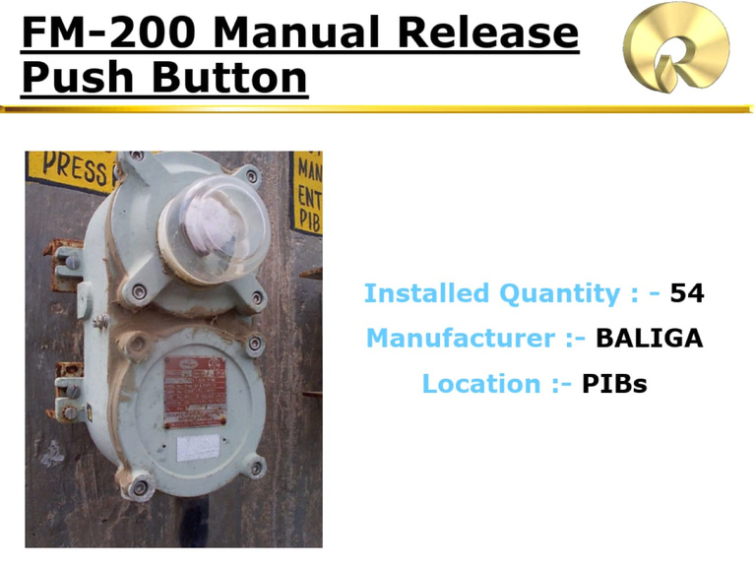

DTA F&G System-Overview
🛢️💥 Fire Detectors
💨Smoke Detectors (DSO, DSI, DSM)
Optical (DSO): Infrared light scattering when smoke particles enter sample volume.
Ionization (DSI): Americium-241 ionizes air; smoke reduces current → triggers alarm.
Multisensor (DSM): Combines optical and thermal sensing via microcontroller logic.
🌡️Heat Detectors (DHR, DHE)
Rate-of-Rise (DHR): Voltage change between two thermistors in bridge circuit.
Linear (DHE): Resistance drop in NTC polymer insulation triggers interface unit.
🔥Flame Detectors (DFI, DFX)
IR (DFI): Triple-band IR sensing CO₂ emission (4.2–4.6 µm) & flicker analysis.
UV/IR (DFX): Detects UV/IR electromagnetic radiation—sensitive to flammable liquids.
Gas Detectors (DGC, DGT)
Combustible Gas Detector(DGC): Detects hydrocarbon gases by measuring the heat of oxidation (catalytic sensor) or IR light absorption specific to flammable gas molecules.
Toxic Gas Detector(DGT): Detects toxic gases like H₂S or CO using electrochemical sensors that produce current from gas-specific redox reactions.

Slide 6
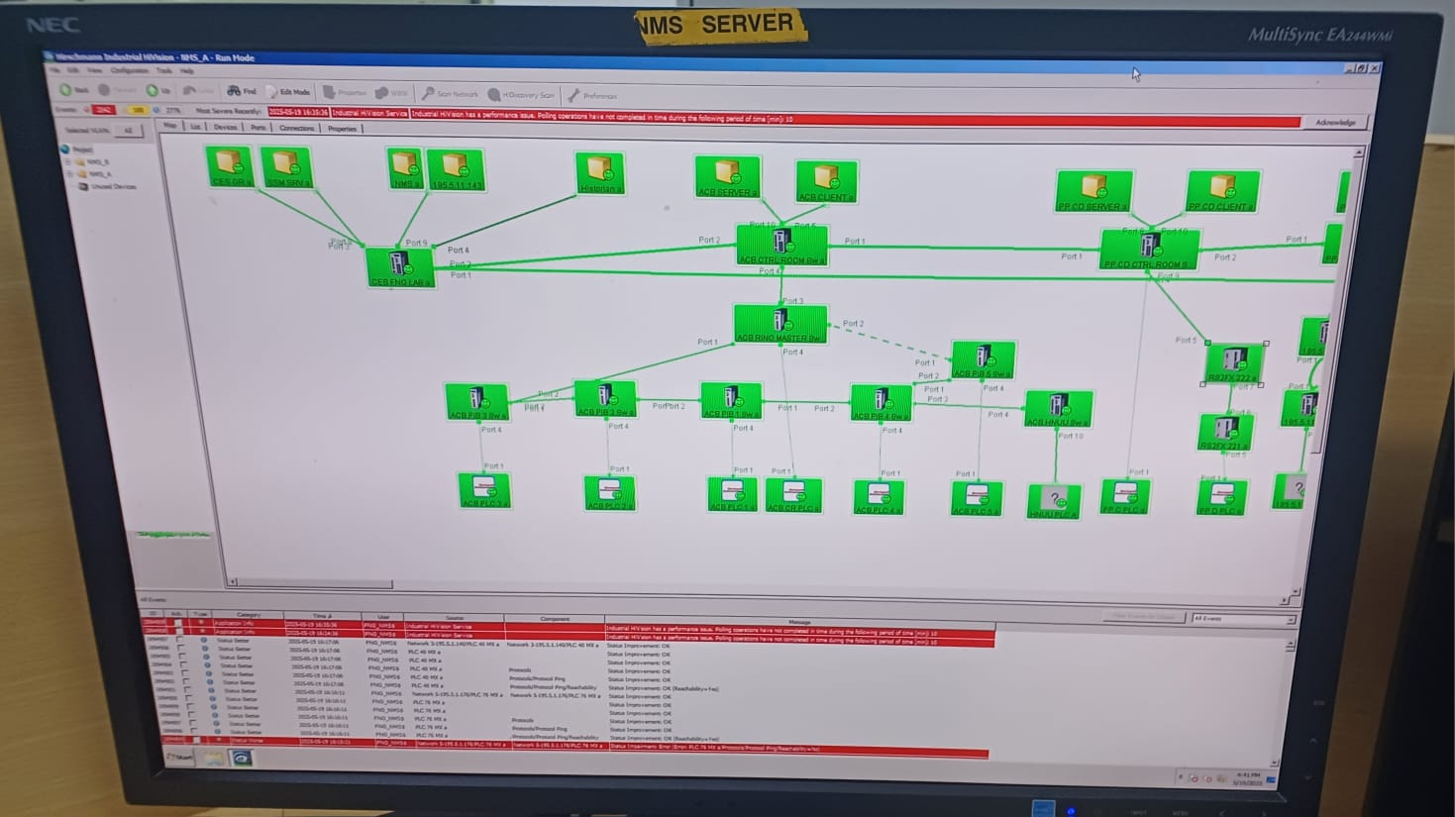
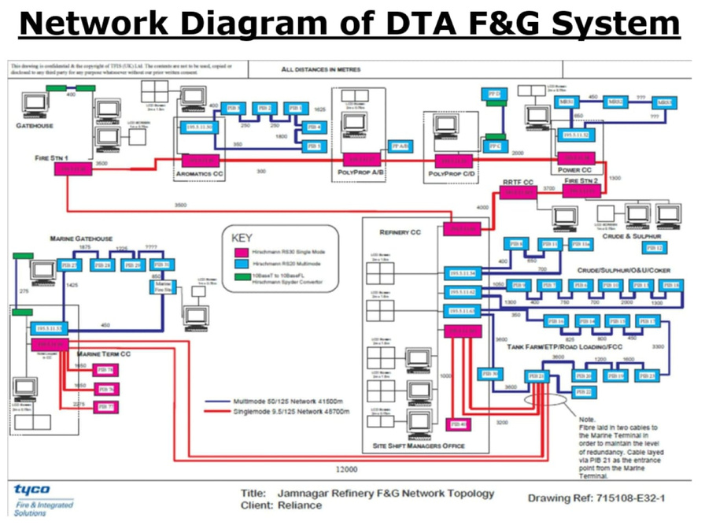
F&G Architecture & SCADA Monitoring – DTA System
🏗 System Architecture
Addressable Devices
These devices (like DSO, DSM, DFI, DMC) are connected in loops via MINERVA 80 or ELTEK controllers. Each controller can handle up to 10 loops, with each loop supporting up to 99 detectors. These devices are centrally managed and individually identified by the controller.
Non-Addressable Devices (Point-to-Point)
Devices like toxic gas detectors (DGT), combustible gas detectors (DGC, DGH, DGX), and flame/heat detectors are connected directly to the PLC I/O rack using dedicated analog inputs (typically 4–20 mA signals). These do not have digital addresses and are polled individually.
🔄 Data Flow
Addressable detector data is processed by MIPLOC (Minerva Interface Programming Logic & Control), which relays status to the PLC.
Non-addressable device data goes straight into the PLC via hardwired analog channels.
The PLC acts as the brain of the system, sending all status and alarm data to the Wonderware SCADA(Supervisory Control and Data Acquisition).
Communication between PLCs, workstations, and SCADA servers is done using Ethernet, with data transmitted through fiber optic cables across the plant.
🖥 SCADA – Wonderware Platform
Dedicated SCADA system separate from DCS, used solely for monitoring F&G systems.
Uses 3-tier graphic visualization:
Level 1: Shows the entire plant area overview.
Level 2: Zooms into individual PIBs or substations.
Level 3: Displays status of each individual detector.
Color Codes on SCADA:
Green : Healthy
Red : Fire alarm
Blue : Toxic gas leak
Orange : Flammable gas leak
Yellow : Fault
White/Grey with Pink box : Not commissioned or disabled

Slide 7
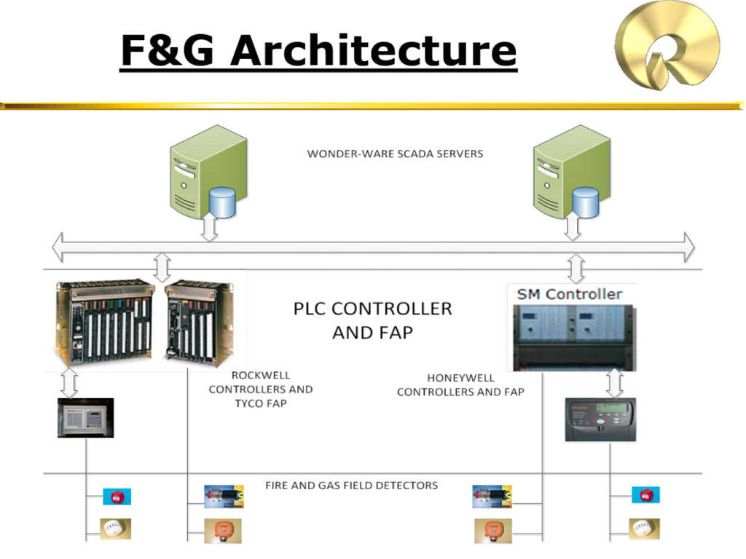
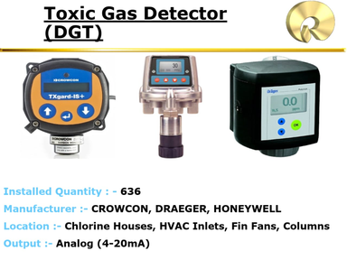
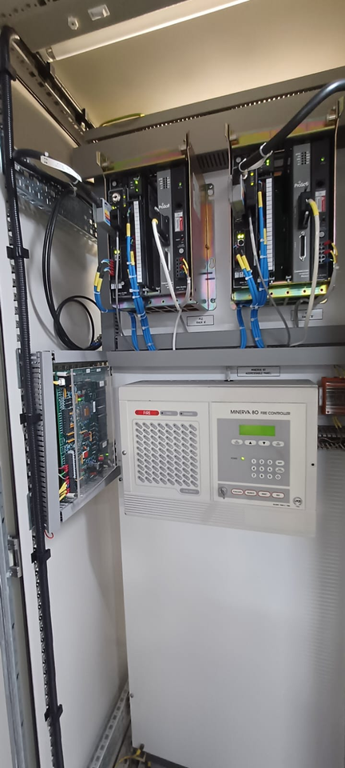

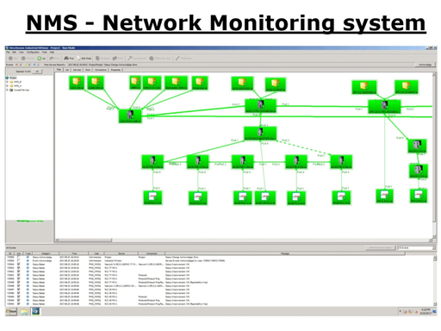
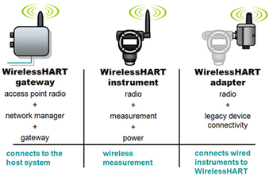
Existing Architecture for Wireless HART-Enabled F&G SIS with SCADA Integration
Field Layer
Gas & Flame Detectors
(Detect Combustible Gases,Toxic Gases and Flames)
Control Layer
PLC/RTU for Safety Logic
(Execute logic for alarm threshlolds,delays,shutdowns)
Output Layer
Actuators, Alarms & Shutdown Systems
(Area Evacuation Alarms,HVAC Shutdown)
System Data Flow
📡➡️📶➡️🧠➡️🌐➡️🖥️
Supervisory & Interface Layer
SCADA & HMI for Visualization & Control
F&G Detector → Wireless HART (via Adapter) → Wireless HART (Mesh Network) → Wireless HART (Gateway) → Safety PLC → SCADA/HMI (via Modbus TCP) → Control Room
(Real-time Monitoring,Alarm Logging)
Communication
Infrastructure
Wireless HART, Gateways & Redundant Monitoring
(Mesh Network Reliability and Security)

Slide 8
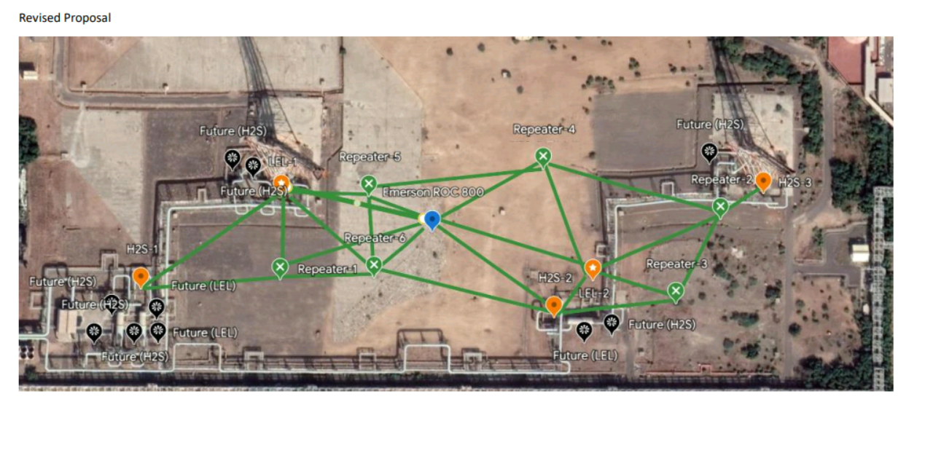
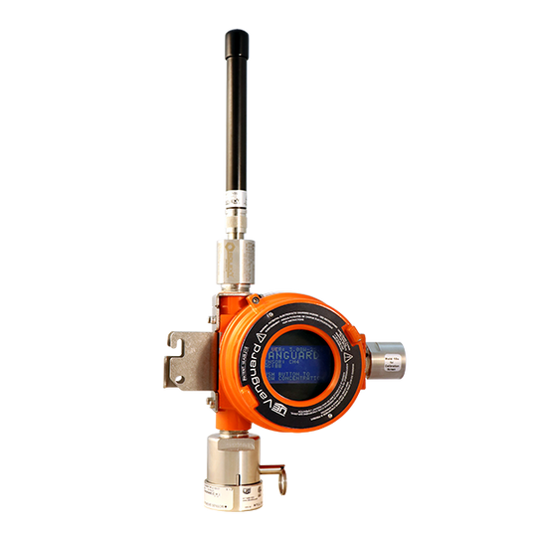
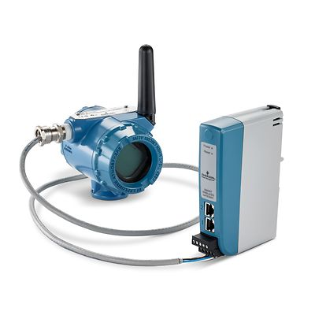
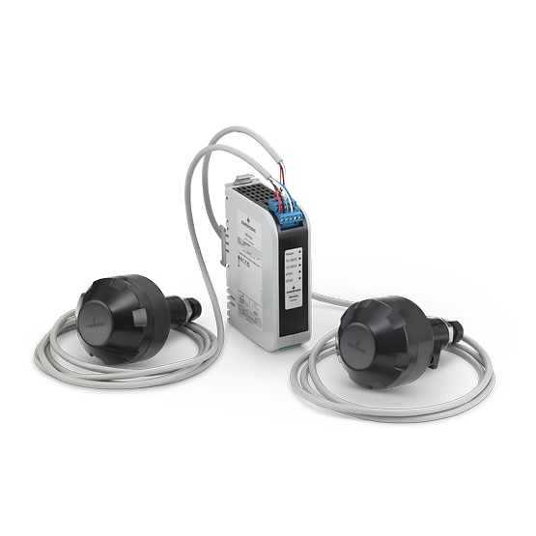
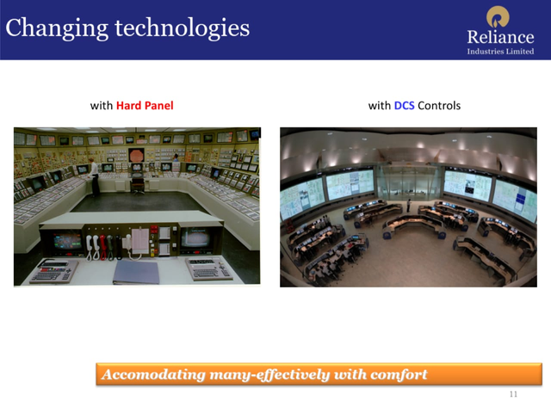
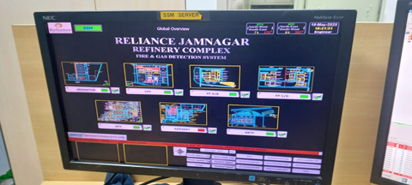
Proposed Wireless System Architecture & Components
FIELD LAYER
Vanguard CH4/H2S Detectors
REPEATER LAYER
648DX1 Repeater - Signal Extension
Structure:
Field Devices: Comprise sensors (electrochemical for H2S, catalytic bead for CH4), a microprocessor, WirelessHART modem, battery pack, and diagnostic circuitry.
Repeaters: Contain a WirelessHART transceiver, RF signal amplifier, routing engine, memory for dynamic routing tables, and intrinsically safe battery pack.
Field Link Antenna: Houses industrial RF receivers/transmitters, surge protection, signal processing units, and weatherproof housing.
Function:
Devices communicate wirelessly by relaying data packets in a multi-hop manner.
Each device receives and forwards data to the next device (“hop”) closer to the gateway.
Repeaters extend communication range and enable mesh network self-healing by providing alternate paths.
The Field Link Antenna acts as the primary receiver, forwarding data to the gateway for integration with control systems.
Communication
Infrastructure
781S - Field Link Antenna
GATEWAY & Control Layer
1410S Gateway ⟶ DCS/PLC
Supervisory & Interface Layer
SCADA/HMI Systems

Slide 9
Detailed Working of Proposed Wireless F&G Detection System
Field Devices - Vanguard Gas Detectors
Models : CH4 Detector (TCD50H1A03M211) and H2S Detector (TCD50H1A04)
Installed near potential leak points — compressor stations, flanges, pressure relief valves, hydrocarbon process units in hazardous zones(In Hydrogen Flare Region as per Project Plan).
WirelessHART-enabled smart detectors certified for ATEX/IECEx Zone 1/Zone 2.
Powered by long-life lithium-thionyl chloride batteries, supporting up to 5 years operation under normal transmission conditions(also depends on scan time).
Transmit gas concentration data periodically using WirelessHART with configurable heartbeat intervals.
Internal Components: Electrochemical sensor module (H2S), catalytic bead sensor (CH4), microprocessor, WirelessHART modem, AES-128 encryption chip and diagnostics module.
Mounting considers accessibility, exposure to leak sources and minimal signal shadowing.
Working: Sensors continuously measure gas concentration and process signals via embedded microprocessor. Data packets are encrypted and sent wirelessly following WirelessHART protocols to the nearest repeater or antenna.

Slide 10
2. Repeater - Model 648DX1D117WA3WM1B5Q4
Installed at intermediate elevations (pipe racks, columns) to maintain line-of-sight and overcome obstructions(In Flare Area).
Internal Structure:
Wireless HART transceiver module for receiving and retransmitting signals.
RF amplifier to boost signal strength.
Routing engine and memory to maintain dynamic routing tables ensuring mesh path redundancy.
Intrinsically safe lithium batteries designed for Zone 1/2 hazardous areas.
Function: Extends wireless communication range, enabling multi-hop mesh routing for reliability and self-healing of network paths.
3. Smart Wireless Field Link Antenna - Model 781SA1P17NA1WP3
Centrally mounted (e.g., rooftops/masts) to aggregate WirelessHART signals from detectors and repeaters.
Contains industrial RF transceiver, surge protection, signal processor, and IP66 weatherproof housing.
Receives multiple WirelessHART packets using TDMA and buffers validated mesh traffic.
Forwards processed signals to 1410S Gateway for SCADA/DCS integration.
Enhances wireless mesh reliability with strong RF reception and routing stability.
Designed for hazardous outdoor zones with ATEX/IECEx compliance and lightning protection.
Supports network scalability and self-healing by acting as a fixed anchor in the mesh.
Reduces wiring and simplifies deployment across large industrial sites.
Minimal maintenance with passive operation and robust construction.
Ensures continuous, redundant data flow critical for gas leak and fire safety detection.

Slide 11
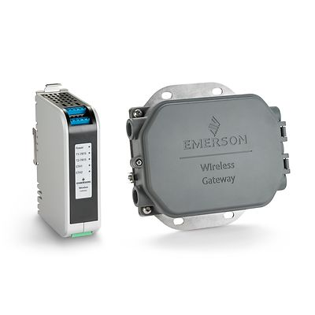
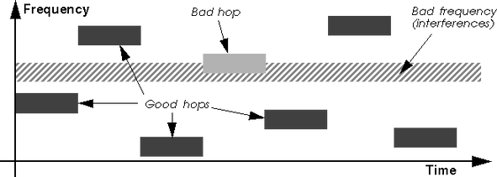
4. Gateway - Model 1410S1AA32AD4N7
Located inside the instrument/control room adjacent to DCS/SCADA.
Internal Modules:
Network Manager orchestrates TDMA slot scheduling and device joining.
Protocol conversion engine translates WirelessHART packets to Modbus TCP/IP or OPC for SCADA integration.
Security firewall and access control for data authentication.
Diagnostics and logging module for network health monitoring.
Function: Acts as the central coordinator of the wireless mesh network, collecting sensor data, managing device statuses, and interfacing with plant control systems.
5. Hop Channel in Wireless Fire & Gas Detection System
Hop: A hop is a single wireless transmission from one device to another.
In Wireless HART, each device (detector/repeater) can act as a hop, forwarding data from neighbors toward the gateway.
Operates in the 2.4 GHz ISM band using 15 channels (11–25).
Uses FHSS (Frequency Hopping Spread Spectrum) and TDMA (Time Division Multiple Access) to assign different channels and timeslots for each hop.
The Network Manager (Gateway) dynamically controls hopping patterns to ensure stable, coordinated communication.
✅ Advantages of Multi-Hop Channel Use :
📶 Avoids Interference – Channel hopping reduces collision and noise impact
🛡️High Reliability – Self-healing mesh ensures alternate paths
🔋 Power Efficient – Shorter hops lower transmission load and extend battery life
🔐Enhanced Security – Channel changes make eavesdropping difficult

Slide 12
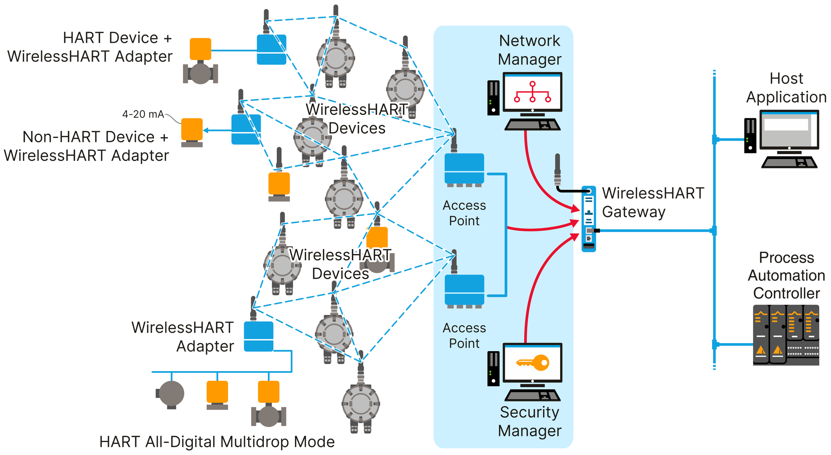

Wireless HART Technology Adoption
WirelessHART (IEC 62591 standard) is embedded in gas detectors, repeaters, antennas, and the gateway to enable secure, real-time wireless communication in hazardous areas.
Smart gas detectors include built-in Wireless HART modems, sensors, microprocessors, and encryption modules to transmit gas concentration data wirelessly.
Repeaters use Wireless HART transceivers and routing engines to enable mesh routing, allowing multi-hop, redundant communication paths that self-heal in case of link failure.
Field Link Antenna with embedded RF circuitry collects Wireless HART signals from the field and sends them to the gateway, ensuring strong, centralized communication coverage.
The 1410S Gateway embeds the Wireless HART Network Manager, converting Wireless HART packets to industrial protocols (Modbus TCP/IP, OPC) and managing the entire mesh network.
TDMA (Time Division Multiple Access) scheduling ensures collision-free, time-synchronized communication across the network for high reliability and determinism.
FHSS (Frequency Hopping Spread Spectrum) enables Wireless HART to operate across 15 channels in the 2.4 GHz band, minimizing interference from nearby wireless systems.
All communication is AES-128 encrypted, authenticated, and monitored via embedded diagnostics, supporting safe and SIL-compliant operation per IEC 61508/61511.

Slide 13

Power Supply & Battery Life and SIS Compliance & Safety Standards Adherence :
Vanguard Gas Detectors: Powered by intrinsically safe lithium-thionyl chloride batteries (3–5 years life); ATEX/IECEx Zone 1/2 certified.
Wireless Repeaters : Intrinsically safe lithium battery powered (3–5 years life); ATEX/IECEx Zone 1/2 certified.
Field Link Antenna : Mains powered with UPS backup; IP66 rated; equipped with surge and lightning protection.
Gateway : Mains powered with UPS; installed in safe control room environment.
Emerson ROC800 RTU: Mains powered with UPS or optional solar backup; mounted in explosion-proof enclosure.
SIS Compliance: Compliant with IEC 61508 and IEC 61511 standards; supports SIL 2/3 applications.
Wireless Protocol Compliance: WirelessHART based on IEC 62591 standard; supports TDMA, FHSS, AES-128 encryption, and mesh routing.

Slide 14


Commissioning Process – Phases
1. Pre-Commissioning
RF Site Survey: Analyze plant layout and topography; identify optimal positions for detectors, repeaters, and antenna ensuring RF overlap, mesh stability, and line-of-sight communication.
Mechanical Installation: Mount detectors near critical leak points (compressors, flanges, valves); install repeaters on elevated structures (pipe racks, columns); position 781 Field Link Antenna at a central, elevated location for optimal signal reception.
Electrical & Communication Readiness: Verify proper sealing, cable routing, grounding, and ATEX/IECEx compliance. Ensure stable UPS supply to the 1410 Gateway and ROC800 RTU (if used).
2. Commissioning
Device Initialization: Power ON battery-operated Vanguard detectors, repeaters, and 1410 Gateway; activate Wireless HART network manager.
Mesh Network Formation: Devices auto-discover and join mesh using TDMA and FHSS protocols. Validate connection, signal strength, and neighbor tables through diagnostics.
Network Configuration: Set device tags, heartbeat intervals, transmission priorities; configure gateway for Modbus TCP/IP or OPC UA output to SCADA/DCS systems.
Functional Testing: Simulate gas leaks to test real-time detector response, alarm activation, and data transmission through mesh hops. Confirm alarm displays on SCADA and data exchange with PLC/DCS.
Redundancy & Self-Healing Check: Temporarily block primary communication paths; verify auto-rerouting and uninterrupted data flow through alternate hops.
3. Post-Commissioning
System Validation & Documentation: Finalize calibration logs, functional test reports, loop diagrams, and device configuration records. Update asset registers.
Operator Training & Handover: Train operations and maintenance teams on Wireless HART diagnostics, SCADA alarm handling, and battery monitoring. Provide SOPs for device updates and replacement.
Maintenance Planning: Schedule periodic battery health checks (3–5 year cycle), RF re-surveys, and firmware updates to maintain network integrity.
Safety Integrity Verification: Validate Safety Integrity Level (SIL 2/3) compliance per IEC 61508/61511. Review configured alarm logic, trip settings, and ESD/shutdown paths.
4. Tools & Software Used
WirelessHART configuration tools (e.g., Emerson AMS), 1410 Gateway diagnostics interface, ROC800 HMI/Web panel, multigas calibrator, SCADA/HMI monitoring and trending software.
5. Key Deliverables
As-built layout and commissioning drawings
Completed checklists and calibration/test reports
Device configuration backups and WirelessHART settings
SCADA tag mapping sheets and logic diagrams
Operator and maintenance training records

Slide 15
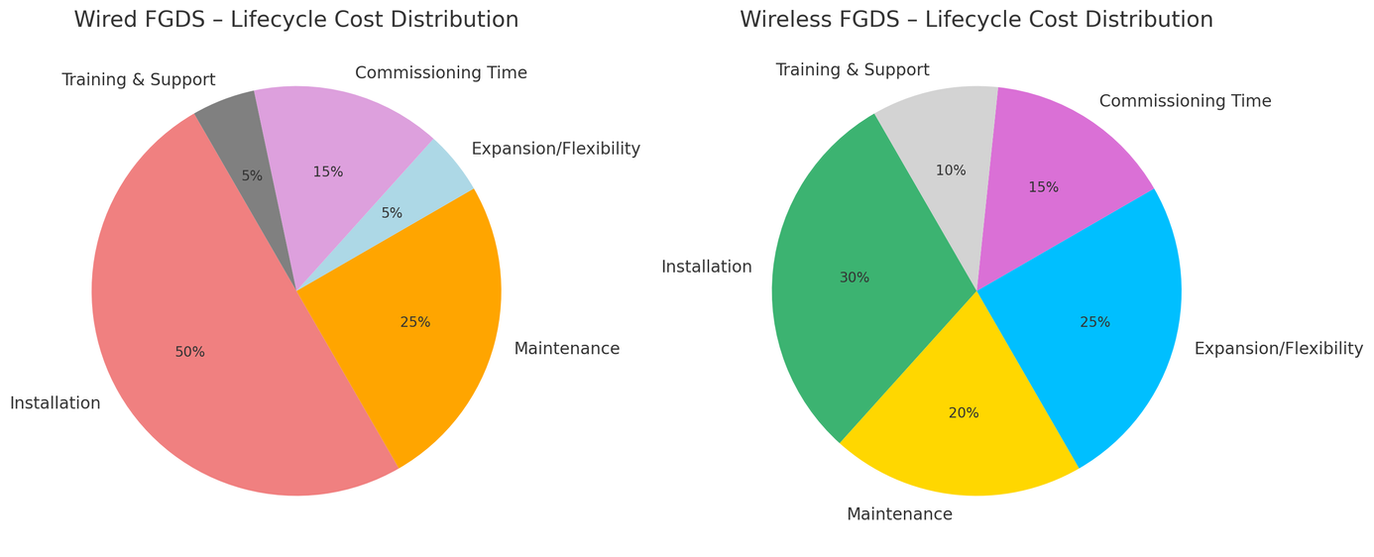
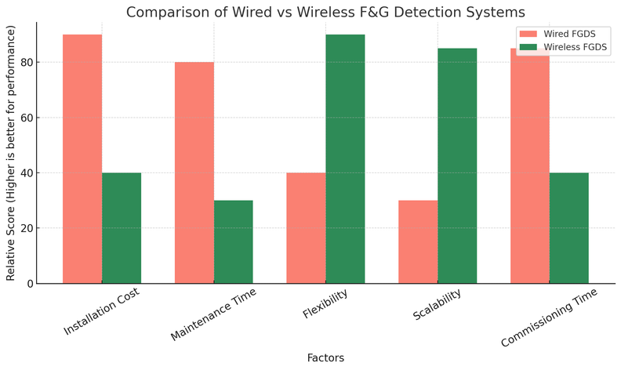
Parameter | Wired System | Wireless System
Installation | Complex; requires cabling, trenching, junction boxes, high labor effort | Simple; cable-free, fast deployment with only mounting required
Commissioning Time | Long; requires full loop checking and signal verification | Short; plug-and-play with auto mesh network formation
Flexibility | Low; relocating or adding devices requires new wiring and design changes | High; devices can be easily added, removed, or repositioned
Scalability | Limited; every expansion demands physical cabling and engineering effort | High; mesh network allows dynamic expansion via repeaters and auto-routing
Maintenance | Labor-intensive; fault tracing, wire corrosion, and access issues common | Minimal; mainly battery health monitoring and remote diagnostics
Communication | Wired 4–20 mA / HART | WirelessHART (IEC 62591), TDMA, FHSS, AES-128 encryption
Redundancy | Manual and costly to implement (duplicate wiring, hardware) | Built-in mesh-based redundancy with self-healing capability
Cost (CAPEX + OPEX) | High; due to materials, labor, downtime, and upgrade constraints | Lower; reduced infrastructure, fast deployment, and minimal downtime
Safety Compliance | SIL 2/3 compliant (IEC 61508/61511), ATEX/IECEx certified | SIL 2/3 compliant (IEC 61508/61511), ATEX/IECEx Zone 1/2 certified wireless devices

Slide 16
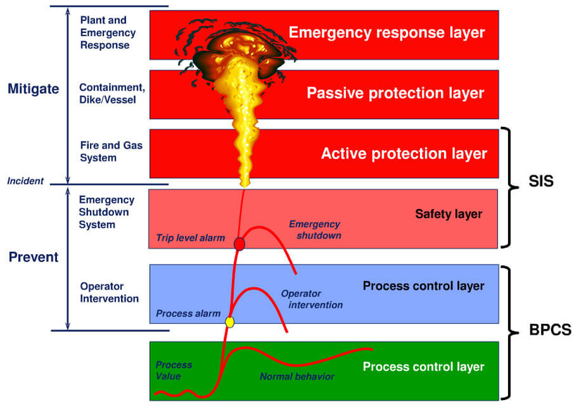
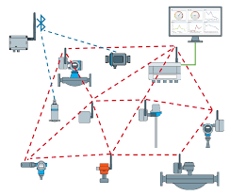

Wireless F&G System – Pros & Cons
✅ Advantages:
Low Installation Cost: No cabling or trenching; reduced CAPEX.
Quick Commissioning: Auto mesh formation via WirelessHART.
High Flexibility & Scalability: Devices can be easily added, moved, or expanded via mesh.
Low Maintenance: Minimal hardware faults; supports remote diagnostics.
Mesh Redundancy: Self-healing network ensures continuous data flow.
Secure Communication: AES-128 encryption with IEC 62591 compliance.
SIL 2/3 Certified: Meets IEC 61508/61511 safety standards.
Hazardous Area Rated: Devices certified for ATEX/IECEx Zone 1/2.
SCADA Integration: Real-time data and diagnostics support.
⚠️ Disadvantages:
Needs RF Planning: Layout and mesh overlap must be carefully designed.
Battery Dependency: Field devices require battery replacement every 3–5 years.
RF Interference Risk: Performance can be affected by EMI or obstructions.
Training Required: Staff must be trained in wireless tech and diagnostics.
Adoption Hesitancy: Resistance from plants accustomed to wired systems
Synopsis & Conclusion:
Upgrading to a Wireless Fire & Gas Detection System using WirelessHART slashes installation costs by up to 50% by eliminating cabling and conduit work. Commissioning time is reduced by 40–60% through plug-and-play device integration and remote diagnostics. The mesh network enables flexible, scalable coverage even in complex plant layouts. Despite minor RF planning and battery maintenance needs, wireless systems offer superior adaptability, faster deployment, and long-term cost efficiency while ensuring full compliance with IEC 61508/61511 safety standards.

Slide 17


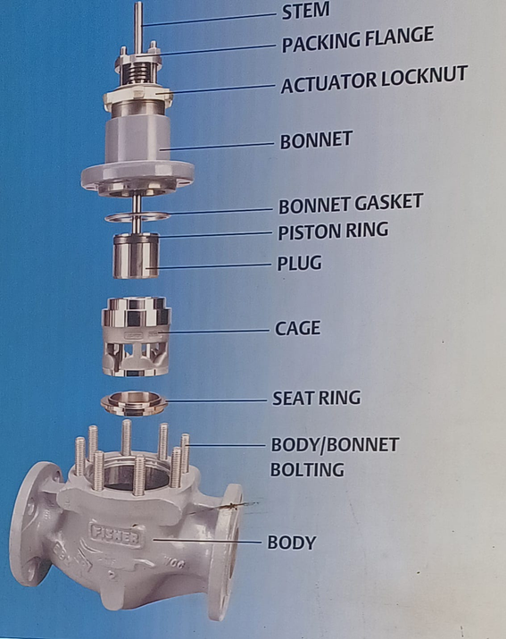
Learnings
Learnings from Project
WirelessHART protocol and mesh routing structure for reliable communication.
Deployment and commissioning process of wireless gas detectors.
Configuration of gateways, repeaters, and field link antennas.
Cost-effective and scalable design compared to wired systems.
RF planning, battery maintenance, and remote diagnostic techniques.
Safety compliance with IEC 61508 and IEC 61511 standards.
Other Learnings
Working and calibration of Control Valve.
Overview and Operation of DCS System.
F&G System of DTA Complex (SMC,NMS,GR Server).
Basic PLC Logic using Allen Bradly RSLogix 500.
Working of different Flow, Temperature , Pressure and Level Measuring Instruments.
Calibration of Rosemount 3051 Pressure Transmitter.
Loading Arm System Operation of Reliance Jetty.

Slide 18
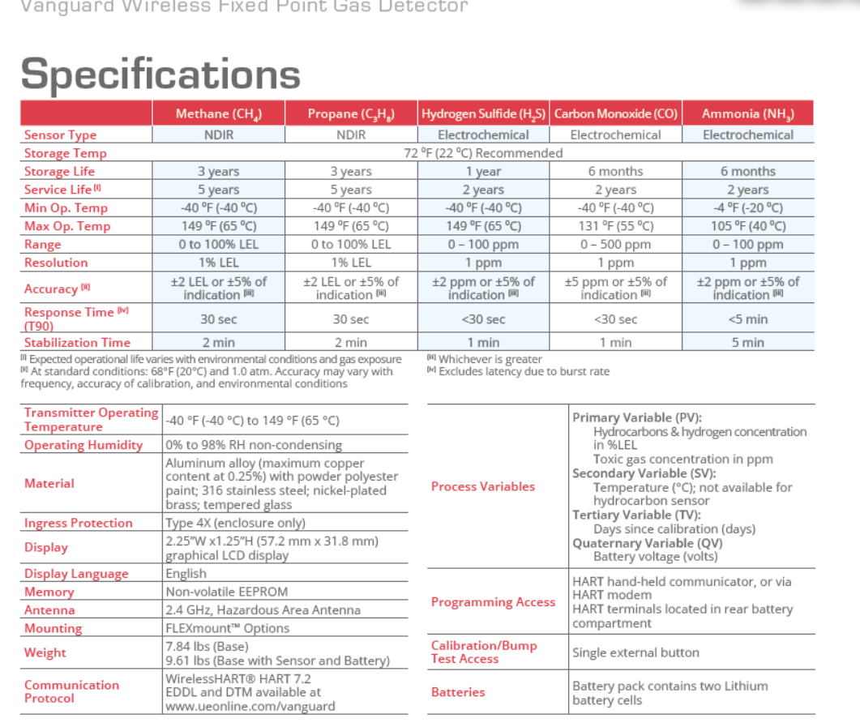
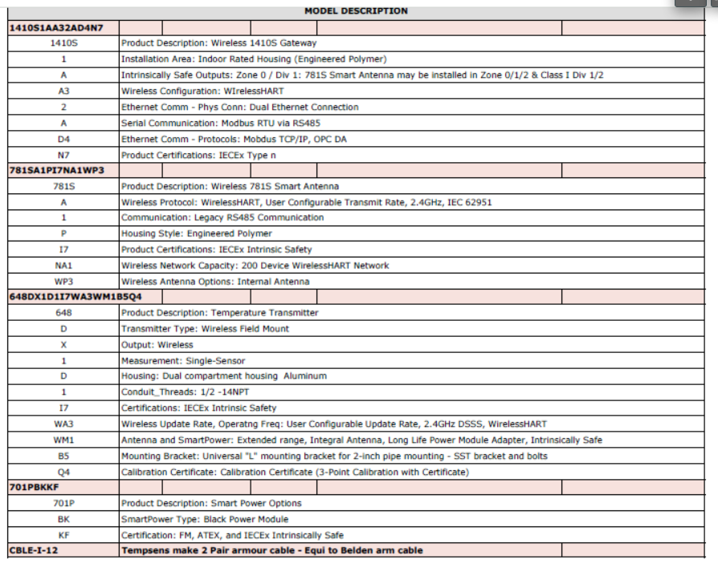
Annexure

Slide 19
Thank
You !
Any
Questions?

